Slide 1
Практическое занятие № 16
PROBE PROCEDURE

Slide 2
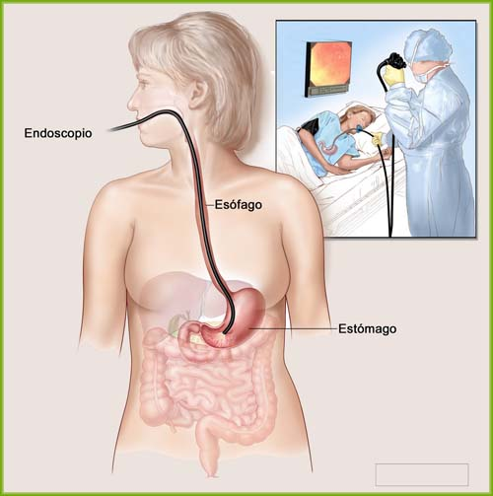
Gastric intubation - medical manipulation, when in the stomach cavity is introduced a stomach pump with diagnostic or therapeutic purposes.

Slide 3
Purpose of Gastric intubation:
gastric lavage
the aspiration of the stomach contents at stomach atony
providing enteral nutrition to the patient.
Gastric probe is a instrument in the form of a hollow tube, which is designed for therapeutic or diagnostic procedures. The distal end of the probe is carefully processed and rounded to provide noninvasive introduction of a probe in stomach and has two to four lateral holes.
Gastric probes divided into 3 types: thin, thick and double-tube. Each of them has its special design features and aimed for different purposes.

Slide 4
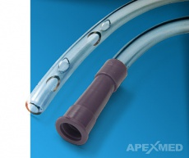
Толстый желудочный зонд представляет собой резиновую трубку диаметром 10—12 мм с просветом 8-12 мм. Один конец зонда, вводимый в желудок, закруглен, выше его имеются два овальных отверстия.
Thick gastric probe is a polyvinylchloride tube in diameter of 10-12 mm. Gastric end of the probe is open, above it there are two oval holes.

Slide 5
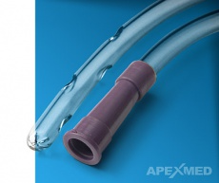
Тонкий зонд имеет длину 1-1,5см и диаметр 3-5 мм. Один конец трубки слепой, на нем имеется 2 отверстия.
Thin gastric probe has a length of 1-1,5 meter and a diameter of 3-5 mm. gastric end of the tube is closed, it has 4 holes at the side.

Slide 6
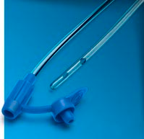
A nasogastric probe (nutritional probe) has a length of 120 cm, the diameter of the lumen - 0,9 - 6 mm. Gastric end of the probe is open, above it there are two oval holes. equipped with a double lid.

Slide 8
SKILL 1. STOMACH LAVAGE WITH THICK GASTRIC PROBE
Purpose: the removal from the stomach of its contents
Equipment.
Sterile: disposable thick gastric probe, vaseline oil, gauze napkins, Janet's syringe,
sterile container for collection of washing water on the testing, medical tray.
Unsterile: funnel with the volume of 0.5-1 liter, a basin to washing water, a bucket of clear water of room temperature 10-12 liters, jug, gloves, 2 oilcloth aprons, pH test strip or phonendoscope, a container for disinfection (tray).
The algorithm of actions:
Explain to the patient the purpose and procedure course. Obtain patient’s consent.
Seat the patient. If the patient is in serious condition - put to bed on his side, turn the head to one side.
Conduct hygienic washing hand and processing hand. Wear gloves.
To prepare the equipment.
Put on an apron on yourself and on the patient.
Remove dentures, if any.
Stand to the right of the patient. Put the basin to the feet of the patient (or to the head end of the couch, if the patient is lying).
Determine the depth to which must be entered the probe. Method of measurement: from nose -to the ear- to xiphoid of the patient. Make the distance of the tube.
Take the probe in the right hand at the distance of 10-15cm from the gastric end, and your left hand to support the free end. Lubricate the gastric end of the probe with lubricant (sterile vaseline oil).

Slide 9
10. Ask the patient to open his mouth, slightly throw back your head.
11. Put the end of the probe on the tongue, offer the patient to make swallowing movements, breathing deeply through the nose. Patient should keep the probe only lips. Continue to advance the tube until it reaches the previously designated mark.
12. Assertion correct placement of the tube:
1 method. Auscultation test: fill the Janet's syringe the air (10-20 ml), connect his to the distal end of the probe, place phonendoscope over the patient epigastrium and inject or air while listening for a whooshing sound.
2 method. pH-test. Aspirate stomach contents, and check the pH, which should be acidic. Rationale: Testing pH is a reliable way to determine location of a feeding tube. Gastric contents are commonly pH 1 to 5, 6 or greater would indicate the contents are from lower in the intestinal tract or in the respiratory tract.
13. Attach the funnel to probe and to lower the level of the stomach. Fill the funnel with water, holding her inclined (to prevent air from entering the stomach) and slowly raise it above the level of the stomach, so that the water came from a funnel into the stomach.
14. Once the water reaches the mouth of the funnel (to watch, that in the estuary of the funnel left the water), to lower the level of the stomach so that the contents of the stomach filled funnel completely.
15. Pour the contents into a basin for washing water. Repeat the lavage to "clean water". If necessary the first washing water to pour in the container for testing (about 100 ml).
16. Carefully remove the probe, using a napkin.
17. Conduct disinfection used material. Take the gloves off and put them in the container for disinfection. Wash hands hygienic way.
18. Make a record of results in a medical documentation.

Slide 10
SKILL 2. STOMACH LAVAGE WITH THIN GASTRIC PROBE
Purpose: the removal from the stomach of its contents, method can be used if the patient is unconscious
Equipment:
Sterile: disposable thin gastric probe, vaseline oil, gauze napkins, Janet's syringe,
sterile container for collection of washing water on the testing, medical tray.
Unsterile: a basin to washing water, a bucket of clear water of room temperature 10-12 liters, gloves, 2 oilcloth aprons, pH test strip or phonendoscope, a container for disinfection (tray).
The algorithm of actions:
Explain to the patient the purpose and procedure course. Obtain patient’s consent.
Seat the patient, If the patient is unconscious – put on his side, turn the head to one side.
Conduct hygienic washing hand and processing hand. Put the gloves on.
Prepare the equipment.
Put on an apron on yourself and on the patient.
Remove dentures, if any.
Put the basin to the feet of the patient (or to the head end of the couch, if the patient is lying).
Determine the depth to which must be entered the probe. Method of measurement: from nose - to the ear - to xiphoid of the patient. Make the distance of the tube.
Take the probe in the right hand at the distance of 10-15cm from the gastric end, and your left hand to support the free end.
Lubricate the gastric end of the probe with lubricant (sterile vaseline oil).
Insert the tube into the selected nostril. Ask the patient to hyperextend the neck, and gently advance the tube toward the nasopharynx.

Slide 11
12. Insert the tube 15-18 сm. Once the tube reaches the oropharynx (throat) the will feel the tube in the throat and may gag and retch.
13. Ask the patient to tilt the head forward and swallow (if the patient is conscious). Continue to advance the tube until it reaches the previously designated mark.
14. Assertion correct placement of the tube:
1 method. Auscultation test: fill the Janet's syringe the air (10-20 ml), connect his to the distal end of the probe, place phonendoscope over the patient epigastrium and inject or air while listening for a whooshing sound.
2 method. pH-test. Aspirate stomach contents, and check the pH, which should be acidic. Rationale: Testing pH is a reliable way to determine location of a feeding tube. Gastric contents are commonly pH 1 to 5, 6 or greater would indicate the contents are from lower in the intestinal tract or in the respiratory tract.
15. Aspirate all stomach contents, pour it into a basin for washing water.
16. The first washing water to pour in the container for testing.
17. Fill the Janet's syringe by water and slowly introduce into the stomach, then to aspirate the liquid contents.
18. Pour the contents into a basin for washing water. Repeat the lavage to "clean water".
19. Carefully remove the probe, using a napkin.
20. Conduct disinfection used material. Take the gloves off and put them in the container for disinfection. Wash hands hygienic way.
21. Make a record of results in a medical documentation.

Slide 12
SKILL 3. INSERTING OF NASOGASTRIC PROBE
Purpose: providing artificial enteral nutrition (gavage feeding)
Equipment. Sterile: disposable nasogastric probe, Janet's syringe, vaseline oil, tray.
Unsterile: gloves, towel, pH test strip or phonendoscope, adhesive plaster, (taping) a container for disinfection (tray).
The algorithm of actions:
Explain to the patient the purpose and procedure course. Obtain patient’s consent.
Seat the patient, If the patient is unconscious – put on his side, turn the head to one side.
Conduct hygienic washing hand and processing hand. Put the gloves on.
Prepare the equipment.
Put on an apron on yourself and on the patient.
Remove dentures, if any.
Put the basin to the feet of the patient (or to the head end of the couch, if the patient is lying).
Determine the depth to which must be entered the probe. Method of measurement: from nose - to the ear - to xiphoid of the patient. Make the distance of the tube.
Take the probe in the right hand at the distance of 10-15cm from the gastric end, and your left hand to support the free end.
Lubricate the gastric end of the probe with lubricant (sterile vaseline oil).
Insert the tube into the selected nostril. Ask the patient to hyperextend the neck, and gently advance the tube toward the nasopharynx.

Slide 13
12. Insert the tube 15-18 сm. Once the tube reaches the oropharynx (throat) the will feel the tube in the throat and may gag and retch.
13. Ask the patient to tilt the head forward and swallow (if the patient is conscious). Continue to advance the tube until it reaches the previously designated mark.
14. Assertion correct placement of the tube:
1 method. Auscultation test: fill the Janet's syringe the air (10-20 ml), connect his to the distal end of the probe, place phonendoscope over the patient epigastrium and inject or air while listening for a whooshing sound.
2 method. pH-test. Aspirate stomach contents, and check the pH, which should be acidic. Rationale: Testing pH is a reliable way to determine location of a feeding tube. Gastric contents are commonly pH 1 to 5, 6 or greater would indicate the contents are from lower in the intestinal tract or in the respiratory tract.
15. Secure the tube by taping it to the nose.
16. Secure the tube to the gown by adhesive plaster.
17. Take the gloves off and put them in the container for disinfection. Wash hands hygienic way.
18. Make a record of results in a medical documentation.

Slide 14
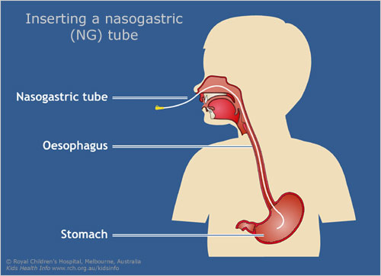

Slide 15
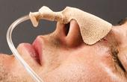
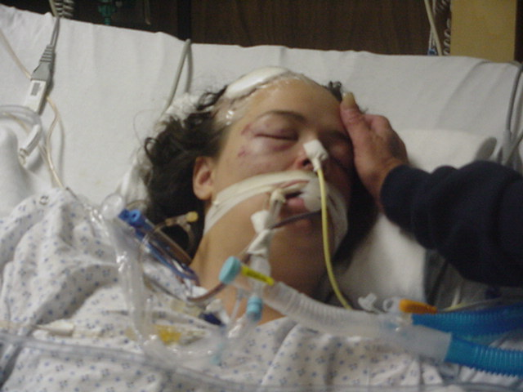

Slide 16
Remember!
• If at the introduction of the probe, patient started coughing, began to breathlessness, appeared cyanosis, immediately remove the probe, as he got into the trachea and not in the esophagus.
• If any probe manipulation in the resulting material has blood – stop the probing!
• In case of high vomiting reflex of patient, the root of the tongue can be processed with an aerosol of 10% solution of lidocaine.

